Slide 1
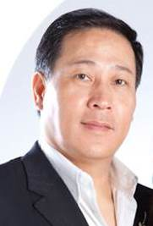
創業者應有的思維
The Mindset as an Entrepreneur
Allen Hu
執行高級顧問經理級
Executive Director
四個佣金週期共賺取HK$191,600
HK$191,600 in 4 Commission weeks
本簡報中提到的收入等級純屬舉例說明，無意代表美安香港超連鎖™店主的一般收入，也無意表示任何超連鎖™店主皆可賺取同等收入。美安香港超連鎖™店主的成功與否，取決於其在發展事業時的努力、才能與投入程度。
The income levels mentioned in the following presentation are for illustration purposes only. They are not intended to represent the income of a typical Market Hong Kong UnFranchise ™Owner, nor are they intended to represent that any given Independent UnFranchise ™ Owner will earn income in that amount. The success of any Market Hong Kong Independent UnFranchise ™ Owner will depend upon the amount of hard work, talent, and dedication which he or she devotes to building his or her Market Hong Kong Business.

Slide 2
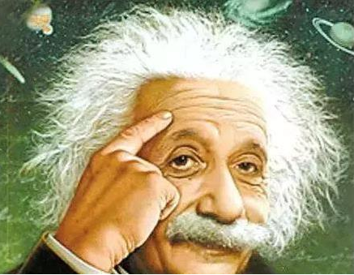
Mindset As Entrepreneur

Slide 3
Mindset as an Entrepreneur
BELIEVE
To be sure
or BELIEVE

Slide 4
Here are two quotes to change your mindset:
Some people ask themselves “Why”before action
I ask myself “Why not?”
Just take the serve and hit an unexpected strike

Slide 5
How to Believe in Yourself
1. Revealing your heart to the ones who know you most
I talked to my friend about my work and I found it difficult to achieve my goals. My friend encouraged me and reminded me of my talent, as well as my past achievements. These processes help me to be more confident, because others can help to find my good side, while I may only see my bad side.

Slide 6
How to Believe in Yourself
2. List out your achieved goals
Think about the goals you have achieved.
And you may even be surprised in some cases.
You can make it! Take some time to make it.
List out all of your achieved goals.
You’ve got a lot more confidence in yourself and you will find
you are more capable than you think you are.

Slide 7
How to Believe in Yourself
3. Find 10 ex-colleagues or friends
Talk with those who understand the way you work and your personality.
Figure out what kind of person you are.
You may understand what kind of person you are through others and be more confident.
Ask them “In your point of view, what kind of advantage do I have? What am I good at?” They would say some talents that you’ve never discovered before.
You will become more confident.

Slide 8
How to Believe in Yourself
4. Sit down and meditate
Meditation helps relieve stress, helps you make decisions, and even improves your brain function.
If you are often in a state of negative thinking, meditation can help you get more positive.
You will become more confident than before.
"It will be helpful to spend some time in meditating on building up your self-confidence."

Slide 9
How to Believe in Yourself
5. Find a successful person to be your mentor
If you have a personal mentor who is smart and can teach you a lot of things
You will become more confident because you think you have a strong backup.
One of the ways to make yourself confident is to find a mentor. He may be a senior in your workplace, who has outstanding achievement and can teach you a lot of things.

Slide 10
How to Prove Your Belief
If your belief only stays in your mind
This is just a word.
If your belief is involved in your move.
This is an action.

Slide 11
How to Prove Your Belief
A person cannot turn their belief into action.
There are only 2 reasons:
1: The desire for happiness is not strong enough
2: The fear of suffering is not enough

Slide 12
How to Prove Your Belief
Word:
I want to be rich.
Action:
I must succeed to get rich.

Slide 13
How to Prove Your Belief
Word: I say what I’ve heard, I teach what I’ve learnt.
Action: I say what I’ve seen, I teach what I’ve done.

Slide 14
How to Prove Your Belief
Word:
I will go all out.
Action:
I must go all out.

Slide 15
How to Prove Your Belief
Word:
I will join the training if I’m free.
Action:
I must join the training unless...

Slide 16
How to Prove Your Belief
Word:
I will buy convention tickets if I have money.
Action:
I save for buying as many tickets as I can.

Slide 17
How to Prove Your Belief
Word:
I have difficulties because I have to take care of my family.
Action:
I will eliminate all difficulties because I have to take good care of my family.

Slide 18
Video

Slide 19
Win by Word vs. Win by Action
If an entrepreneur doesn’t put belief into action,
those nice words on your mind are meaningless.

Slide 20
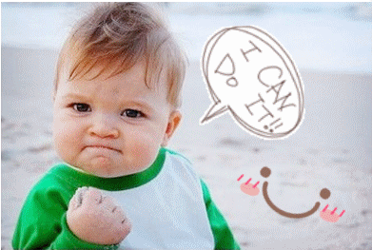
All the ways are difficult
when you lost belief.
All difficulties are ways out
when you believe.
If you are always with a Loser's mind.
how can you be the Winner?

Slide 21
What motivates a person to succeed is not flowers and applause, but those which can put a dead end to someone--
Blow and Frustration!

Slide 22
Mindset as an Entrepreneur
Change mindset before you change life

